Slide 1


Intro to Comm Networks
Instructor:
Dr. Amr El Mougy
TA:
Ahmed Helmy
Ahmed Adel
Moustafa Gouda
**Slides are attributed to J. F. Kurose

Slide 2
People and Resources
Instructor: Amr El Mougy
Email: amr.elmougy@guc.edu.eg

Slide 3
Course Outline
Topics:
  Protocol Layering
  Application Layer: Http, DNS
  Transport Layer: UDP, TCP
  Network Layer: Routing, IP addressing, Autonomous Systems, BGP
  Data Link Layer
Textbook:
  Computer Networking, A Top-Down Approach Featuring the Internet, James F. Kurose & Keith W. Ross, ISBN 0-321-26976-4
  Slide contents are copyrighted to: 1996-2010, J.F Kurose and K.W. Ross, All Rights Reserved

Slide 4
Assessment

Slide 5

Important Note
These slides are not meant to be comprehensive lecture notes! They are only remarks and pointers. The material presented here is not sufficient for studying for the course
Your main sources for studying are:
• the text book and
• your own lecture notes

Slide 6
Introduction: Roadmap
  1.1 What is the Internet?
  1.2 Network edge
    end systems, access networks, links
  1.3 Network core
    circuit switching, packet switching, network structure
  1.4 Delay, loss and throughput in packet-switched networks
  1.5 Protocol layers, service models

Slide 7

What’s the Internet: “nuts and bolts” view
billions of connected computing devices:
  hosts = end systems
  running network apps
communication links
  fiber, copper, radio, satellite
  transmission rate = bandwidth
routers:
  forward packets (chunks of data)
Mobile network
PC
Global ISP
server
wireless
laptop
Home network
cellular
handheld
Regional ISP
access
points
Institutional network
wired
links
router

Slide 8


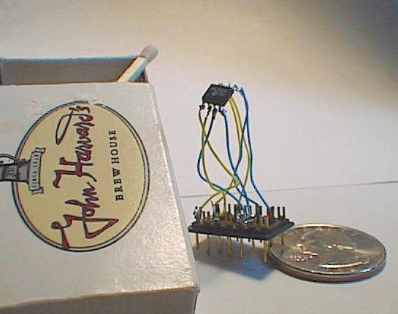

“Cool” internet appliances
Web-enabled toaster +
weather forecaster
IP picture frame
http://www.ceiva.com/
World’s smallest web server
http://www-ccs.cs.umass.edu/~shri/iPic.html
Internet phones

Slide 9
What’s the Internet: “nuts and bolts” view
protocols control sending, receiving of msgs
  e.g., TCP, IP, HTTP, Skype, Ethernet
Internet: “network of networks”
  loosely hierarchical
  public Internet versus private intranet
Internet standards
  RFC: Request for comments
  IETF: Internet Engineering Task Force
Mobile network
Global ISP
Home network
Regional ISP
Institutional network

Slide 10
What’s a protocol?
human protocols:
“what’s the time?”
“I have a question”
introductions
… specific msgs sent
… specific actions taken when msgs received, or other events
network protocols:
machines rather than humans
all communication activity in Internet governed by protocols
protocols define format, order of msgs sent and received among network entities, and actions taken on msg transmission, receipt

Slide 11


What’s a protocol?
a human protocol and a computer network protocol:
Hi
TCP connection
request
Hi
TCP connection
response
Got the
time?
Get http://www.awl.com/kurose-ross
2:00
<file>
time

Slide 12
What’s the Internet: a service view
APIs specify how software asks the Internet infrastructure to deliver data
Communication infrastructure enables distributed applications:
  Web, VoIP, email, games, e-commerce, file sharing
Communication services provided to apps:
  reliable data delivery from source to destination
  “best effort” (unreliable) data delivery

Slide 13
Network Edge
- End systems,
- access networks,
- links

Slide 14
A closer look at network structure:
Network edge:
  applications and hosts
Access networks, physical media:
  wired, wireless communication links
Network core:
  interconnected routers
  network of networks

Slide 15
The network edge:
end systems (hosts):
  run application programs
  e.g. Web, email
  at “edge of network”
client/server model:
  client host requests, receives service from always-on server
  e.g. Web browser/server; email client/server
peer-peer model:
  minimal (or no) use of dedicated servers
  e.g. Skype, BitTorrent
peer-peer
client/server

Slide 16
Access networks and physical media
Q: How to connect end systems to edge router?
residential access nets
institutional access networks (school, company)
mobile access networks
Keep in mind:
bandwidth (bits per second) of access network?
shared or dedicated?

Slide 17
Dial-up Modem
1-16
central
office
telephone
network
Internet
home
PC
home
dial-up
modem
ISP
modem
(e.g., AOL)
Uses existing telephony infrastructure
  Home is connected to central office
up to 56Kbps direct access to router (often less)
Can’t surf and phone at same time: not “always on”

Slide 18
Digital Subscriber Line (DSL)
1-17
Existing phone line:
0-4KHz phone; 4-50KHz upstream data; 50KHz-1MHz downstream data
home
phone
Internet
DSLAM
telephone
network
splitter
DSL
modem
central
office
home
PC
  Also uses existing telephone infrastructure
  Rates can reach several tens of Mbps in the downstream and upstream
  dedicated physical line to telephone central office

Slide 19
Residential access: cable modems
Does not use telephone infrastructure
  Instead uses cable TV infrastructure
HFC: hybrid fiber coax
  asymmetric: up to 30Mbps downstream, 2 Mbps upstream
network of cable and fiber attaches homes to ISP router
  homes share access to router
  unlike DSL, which has dedicated access

Slide 20

Cable Network Architecture: Overview
Typically 500 to 5,000 homes
cable headend
cable distribution
network (simplified)
home

Slide 21
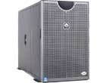
Cable Network Architecture: Overview
server(s)
cable headend
cable distribution
network
home

Slide 22
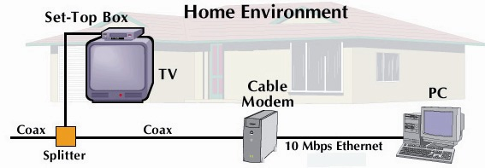
Cable Network Architecture: Overview
cable headend
cable distribution
network (simplified)
home

Slide 23
Cable Network Architecture: Overview
FDM (more shortly):
C
O
N
T
R
O
L
V
I
D
E
O
V
I
D
E
O
V
I
D
E
O
V
I
D
E
O
V
I
D
E
O
V
I
D
E
O
D
A
T
A
D
A
T
A
1
2
3
4
5
6
7
8
9
Channels
cable headend
cable distribution
network
home

Slide 24
Ethernet Internet access, e.g. Institutional
100 Mbps
Institutional
router
Ethernet
switch
To Institution’s
ISP
100 Mbps
1 Gbps
100 Mbps
server
Typically used in companies, universities, etc.
  10 Mbps, 100Mbps, 1Gbps, 10Gbps Ethernet
  Today, end systems typically connect into Ethernet switch

Slide 25
Wireless access networks
shared wireless access network connects end system to router
  via base station aka “access point”
wireless LANs:
  802.11b/g/n (WiFi): 11/54/100 Mbps
wider-area wireless access
  provided by telecommunication operator
  ~10Mbps over cellular system, e.g. HSPA,
  next up (?): WiMAX and LTE (10’s Mbps) over wide area
router
base
station
mobile
hosts

Slide 26
Home networks
Typical home network components:
DSL or cable modem
router/firewall/NAT
Ethernet
wireless access point
wireless
laptops
to/from
cable
headend
Cable/
DSL
modem
router/
firewall
wireless
access
point
Ethernet

Slide 27
Chapter 1: roadmap
  1.1 What is the Internet?
  1.2 Network edge
    end systems, access networks, links
  1.3 Network core
    circuit switching, packet switching, network structure
  1.4 Delay, loss and throughput in packet-switched networks
  1.5 Protocol layers, service models

Slide 28
The Network Core
mesh of interconnected routers
How is data transferred through net?
  circuit switching: dedicated circuit per call: telephone net
  packet-switching: data sent thru net in discrete “chunks”

Slide 29
Network Core: Circuit Switching
End-end resources reserved for “call”
link bandwidth, switch capacity
dedicated resources: no sharing
circuit-like (guaranteed) performance
call setup required

Slide 30
Network Core: Circuit Switching
network resources (e.g., bandwidth) divided into “pieces”
pieces allocated to calls
resource piece idle if not used by owning call (no sharing)
Piece:
  frequency division
  time division

Slide 31
Circuit Switching: FDM and TDM
FDM
Example:
4 users
frequency
time
TDM
frequency
time
Notes:
Two simple multiple access control techniques.
Each mobile’s share of the bandwidth is divided into portions for the uplink and the downlink. Also, possibly, out of band signaling.
As we will see, used in AMPS, GSM, IS-54/136

Slide 32
Network Core: Packet Switching
each end-end data stream divided into packets
user A, B packets share network resources
each packet uses full link bandwidth
resources used as needed
resource contention:
aggregate resource demand can exceed amount available
congestion: packets queue, wait for link use
store and forward: packets move one hop at a time
  Node receives complete packet before forwarding
Bandwidth division into “pieces”
Dedicated allocation
Resource reservation

Slide 33
Packet Switching: Statistical Multiplexing
100 Mb/s
Ethernet
A
C
statistical multiplexing
1.5 Mb/s
B
queue of packets
waiting for output
link
D
E
Sequence of A & B packets does not have fixed pattern, bandwidth shared on demand ➔ statistical multiplexing

Slide 34
Packet-switching: store-and-forward
L
R
R
R
takes L/R seconds to transmit (push out) packet of L bits on to link at R bps
store and forward: entire packet must arrive at router before it can be transmitted on next link
delay = 3L/R (assuming zero propagation delay)
Example:
L = 7.5 Mbits
R = 1.5 Mbps
transmission delay = 15 sec
more on delay shortly …

Slide 35
Packet switching versus circuit switching
Packet switching allows more users to use the Internet!
1 Mb/s link
each user:
  100 kb/s when “active”
  active 10% of time
circuit-switching:
  10 users
packet switching:
  with 35 users, probability > 10 active at same time is less than .0004
N users
1 Mbps link

Slide 36
Packet switching versus circuit switching
packet switching
great for bursty data
  resource sharing
  simpler, no call setup
excessive congestion: packet delay and loss
  protocols needed for reliable data transfer, congestion control
Q: How to provide circuit-like behavior?
  bandwidth guarantees needed for audio/video apps
  still an unsolved problem (Free Reading: chapter 7)

Slide 37
Internet structure: network of networks
roughly hierarchical
at center: “tier-1” ISPs (e.g., Verizon, Sprint, AT&T, Cable and Wireless), national/international coverage
  treat each other as equals
Tier-1 providers interconnect (peer) privately
Tier 1 ISP
Tier 1 ISP
Tier 1 ISP

Slide 38
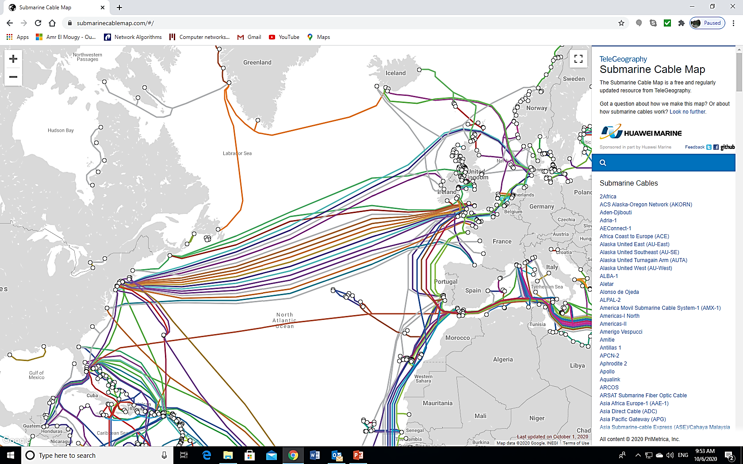
Tier 1 Networks

Slide 39
Internet structure: network of networks
“Tier-2” ISPs: smaller (often regional) ISPs
  Connect to one or more tier-1 ISPs, possibly other tier-2 ISPs
Tier-2 ISPs also peer privately with each other
Tier-2 ISP pays tier-1 ISP for connectivity to rest of Internet
tier-2 ISP is customer of
tier-1 provider
Tier-2 ISP
Tier-2 ISP
Tier 1 ISP
Tier 1 ISP
Tier 1 ISP
Tier-2 ISP
Tier-2 ISP
Tier-2 ISP

Slide 40
Internet structure: network of networks
“Tier-3” ISPs and local ISPs
  last hop (“access”) network (closest to end systems)
local
ISP
Tier 3
ISP
local
ISP
local
ISP
local
ISP
Local and tier- 3 ISPs are customers of
higher tier ISPs
connecting them to rest of Internet
Tier-2 ISP
Tier-2 ISP
Tier 1 ISP
Tier 1 ISP
Tier 1 ISP
Tier-2 ISP
Tier-2 ISP
Tier-2 ISP
local
ISP
local
ISP
local
ISP
local
ISP

Slide 41
Internet structure: network of networks
a packet passes through many networks!
local
ISP
Tier 3
ISP
local
ISP
local
ISP
local
ISP
Tier-2 ISP
Tier-2 ISP
Tier 1 ISP
Tier 1 ISP
Tier 1 ISP
Tier-2 ISP
Tier-2 ISP
Tier-2 ISP
local
ISP
local
ISP
local
ISP
local
ISP

